Slide 1


PREDICTIVE MAINTENANCE
Yiming Feng
Henri von Schuckmann
Henry Nicholas Chettiar

Slide 2
Content
Pre Compression & Main Compression
Sensors
Humidity
Prediction Model
1
3
5
7
2
4
6
8
Data Transformation
Standard Deviation
Temperature
Pressure

Slide 3
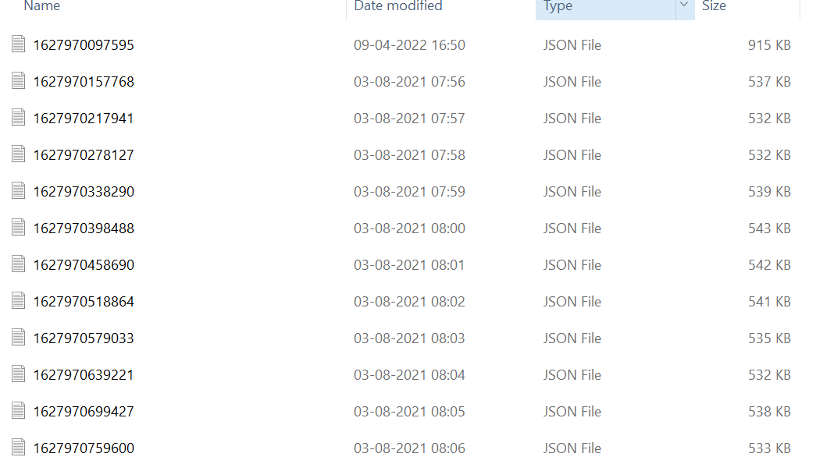
Data transformation
Dates:
3rd, 4th, 5th, 6th August 2021
Total Files:
Approximately 5000 JSON files

Slide 4
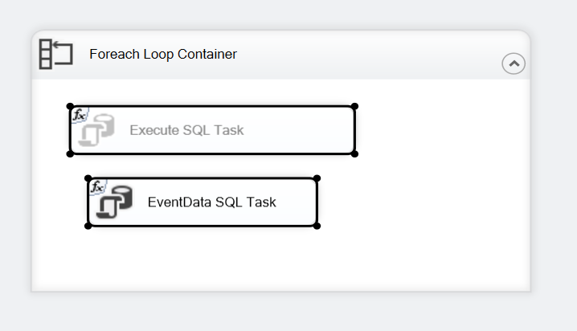
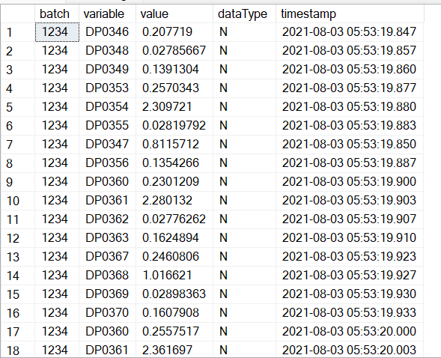
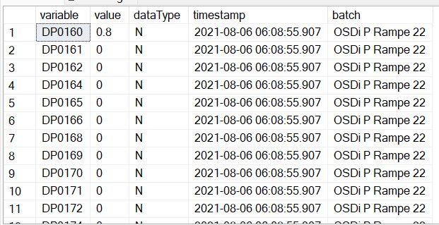
Data transformation
SSIS
Complete Dataset
Event Dataset

Slide 5
Data analysis
Products
Placebo
Placebo/ Monitol
8
6
4
8
4
6
Main compression force (SET)
Main compression force (SET)

Slide 6
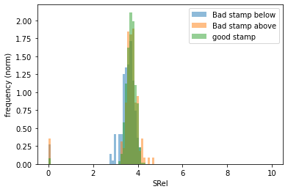
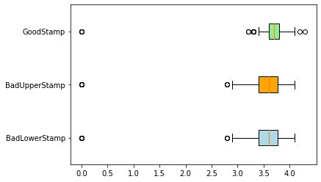
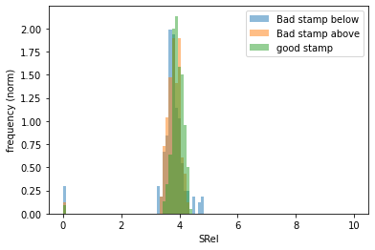
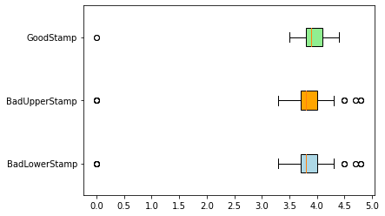
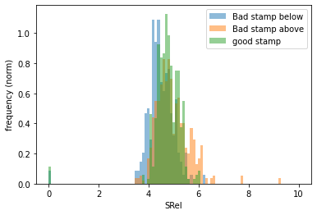
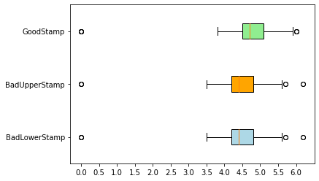
Analysis – Standard deviation
Placebo
8
Observations:
8
Standard deviation for higher preset value(8) is relatively lower compared to lesser preset value(4)
(Referring Box plot). Surprisingly, the standard deviation for good punch is slightly higher than other 2 bad punches in all the 3 preset values.
.
6
6
4
4

Slide 7
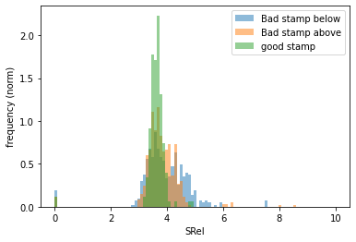
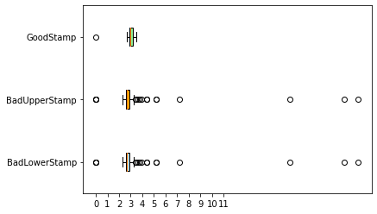
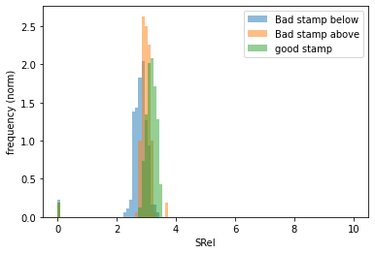
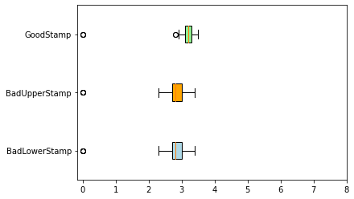
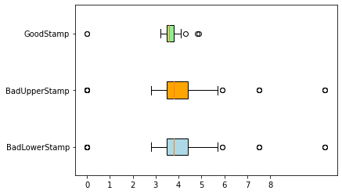
Analysis – Standard deviation
Placebo/ Monitol
8
Observations:
8
Standard deviation for higher preset value(8) is relatively lower compared to lesser preset value(4)
(Referring Box plot). Surprisingly, the standard deviation for good punch is slightly higher than other 2 bad punches in all the 3 preset values,
.
6
6
4
4

Slide 8
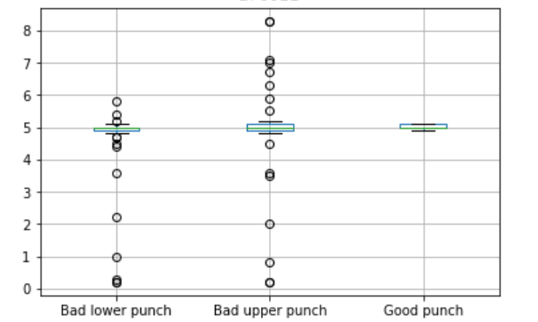
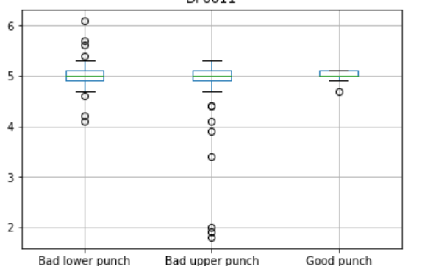
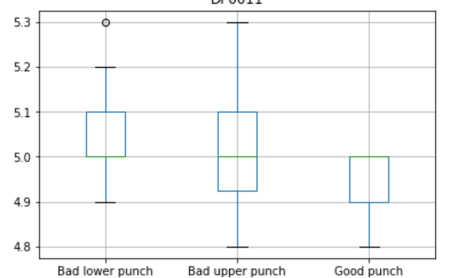
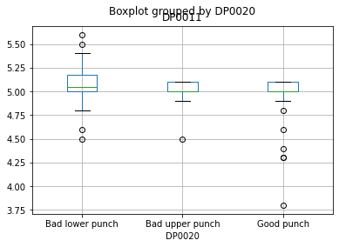
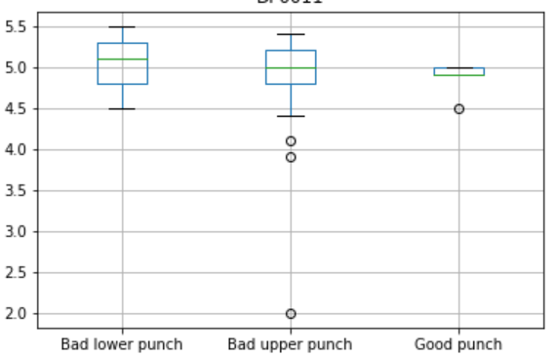
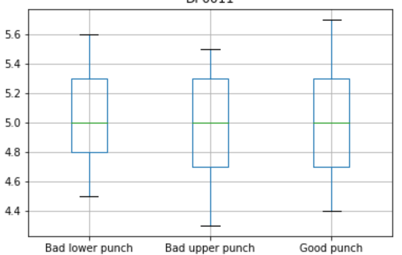
Analysis – Precompression force
Placebo/Monitol
Placebo
8
8
Observations:
Could not find any significant difference in PrePressure between good and bad punch batches.
6
6
4
4

Slide 9
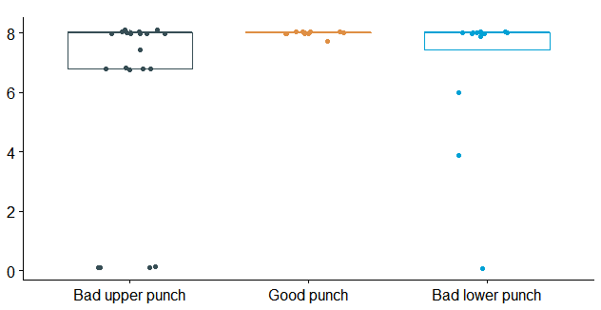
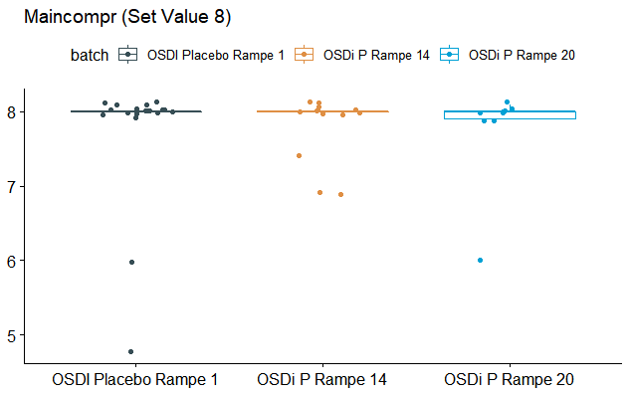
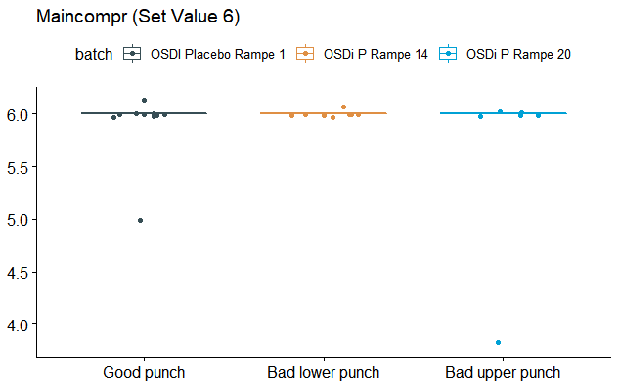
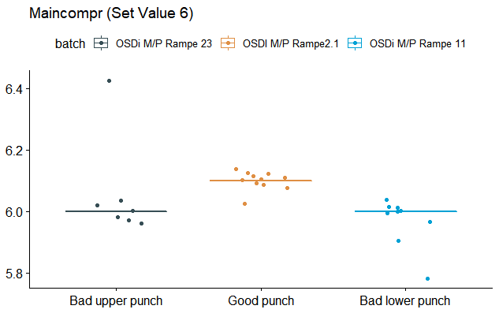
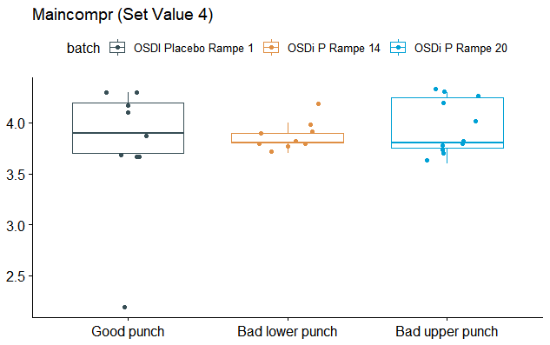
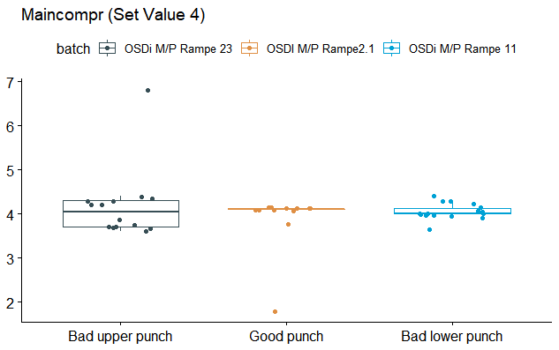
Analysis - Main compression force
Placebo/Monitol
Placebo
8
8
Observations:
Could not find any significant difference in MainPressure, except value 6 in Placebo/Monitol
6
6
4
4

Slide 10
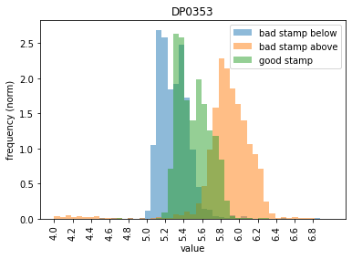
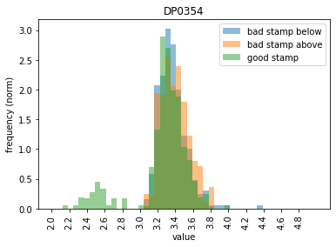
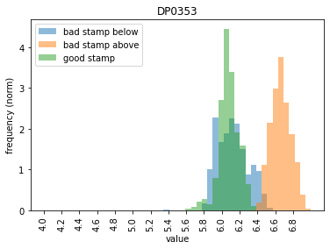
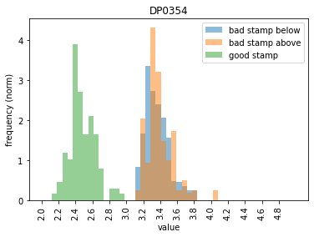
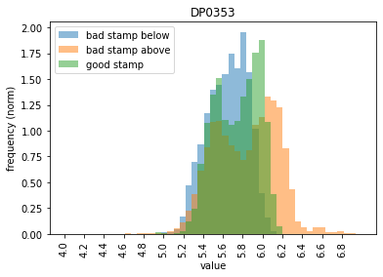
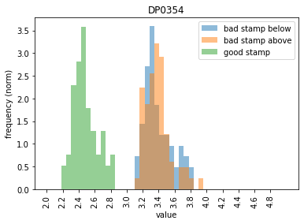
Analysis - Main compression Frequency sensor
Placebo
8
Observations:
8
‘Bad upper stamps’ have slightly higher values compared to good stamps.
6
6
4
4

Slide 11
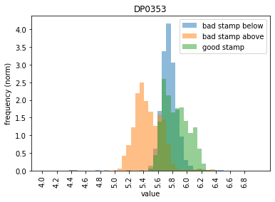
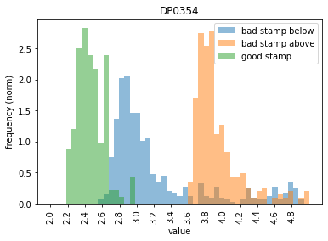
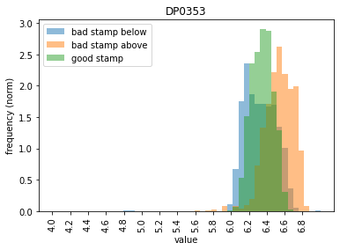
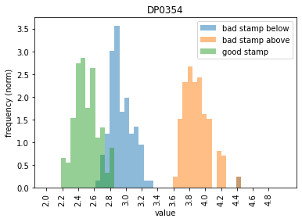
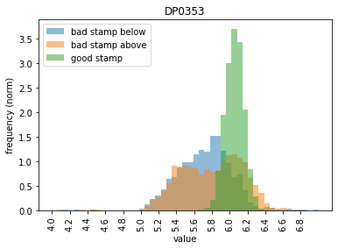
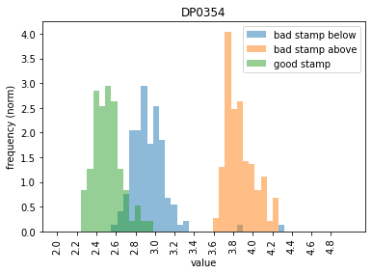
Analysis - Main compression Frequency sensor
Placebo/
Monitol
8
Observations:
8
‘Bad upper stamps’ have slightly higher values compared to good stamps.
6
6
4
4

Slide 12
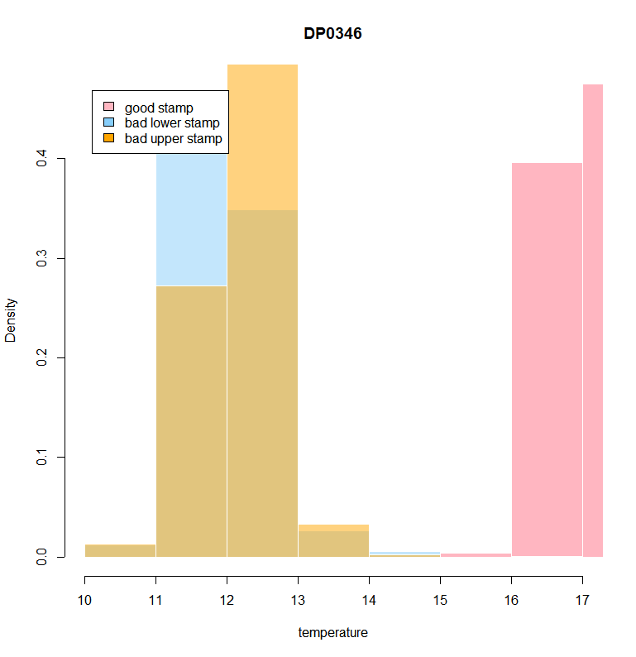
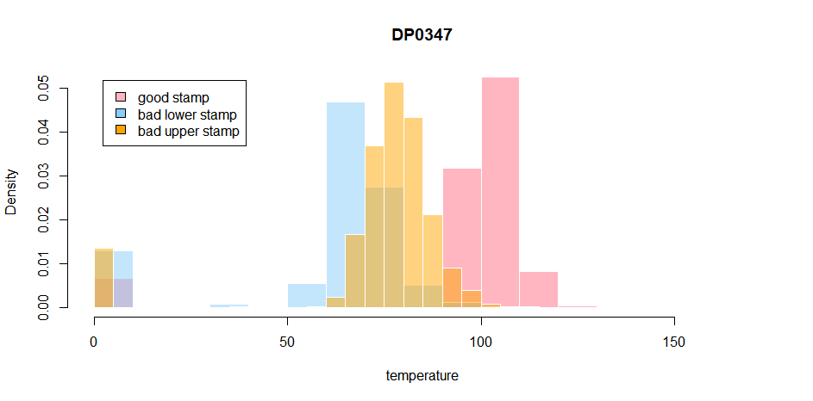
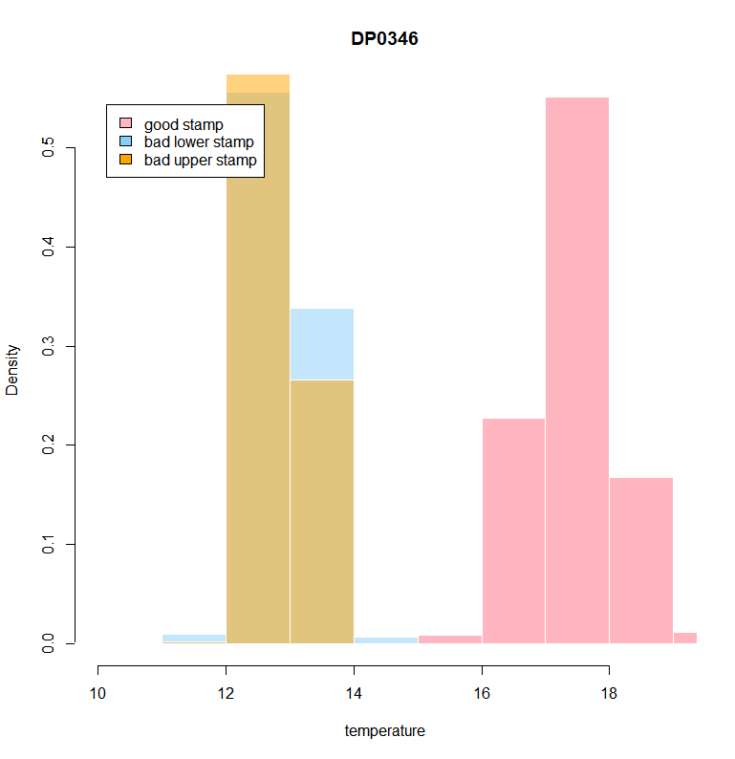
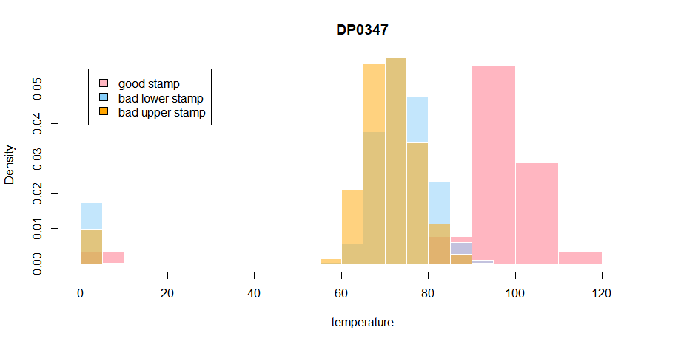
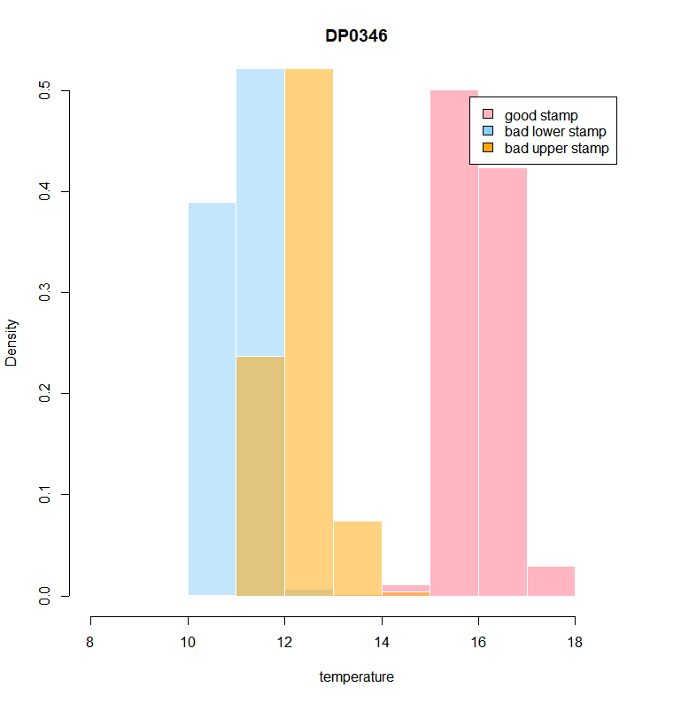
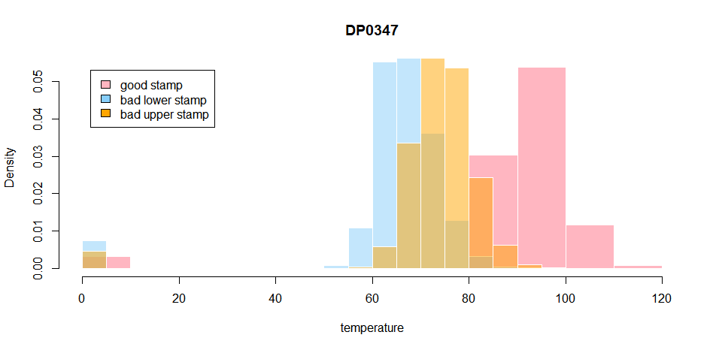
Analysis - Ejection Frequency sensor
Placebo
8
Observations:
8
‘Bad lower stamps’ have slightly lower values compared to good stamps
6
6
4
4

Slide 13
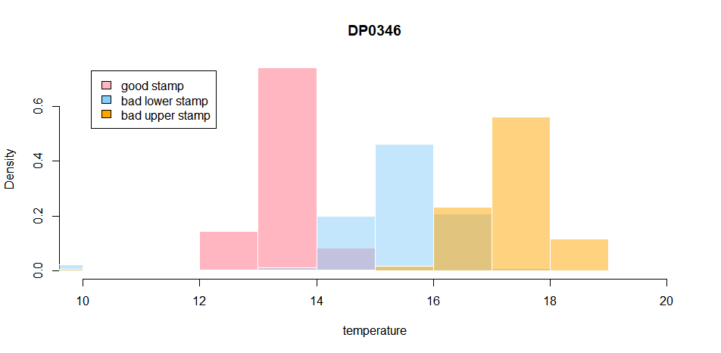
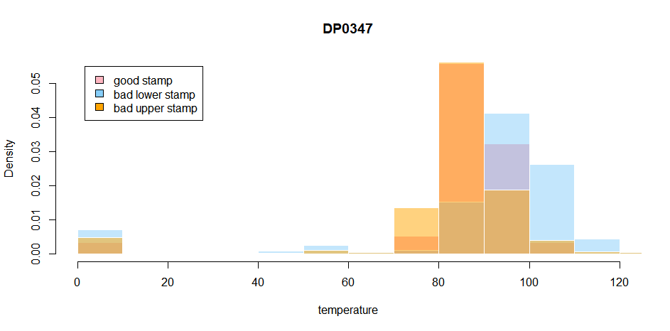
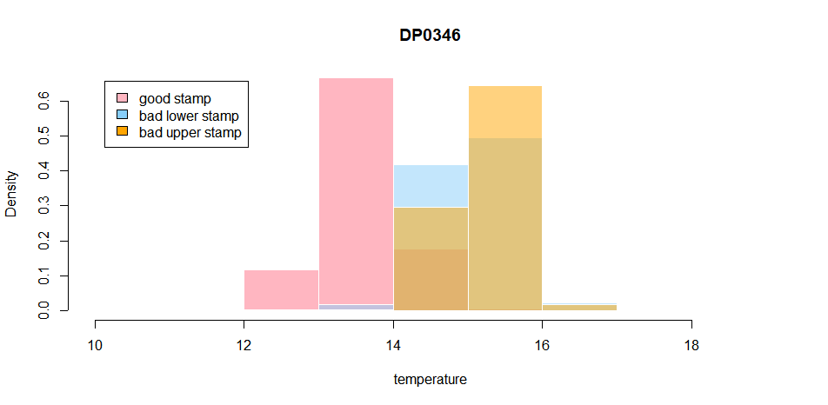
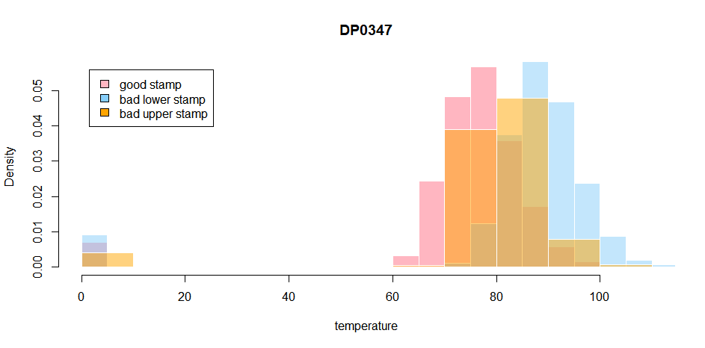
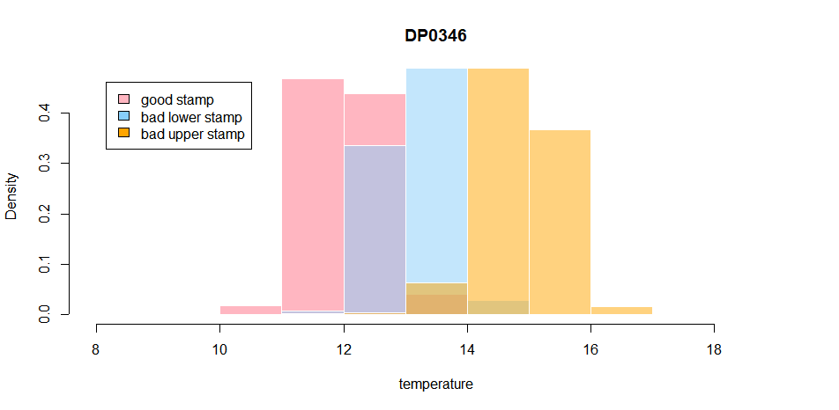

Analysis - Ejection Frequency sensor
Placebo/
Monitol
8
Observations:
8
‘Bad upper stamps’ have slightly higher values compared to good stamps
6
6
4
4

Slide 14






Temperature Analysis - Main compression sensor & Main motor
Placebo
8
Observations:
8
‘Bad upper stamps’ have recorded significantly higher temperature compared to good stamps
6
6
4
4

Slide 15






Temperature Analysis - Main compression sensor & Main motor
Placebo/
Monitol
8
Observations:
8
‘Bad lower stamps’ have recorded significantly higher temperature compared to good stamps
6
6
4
4

Slide 16






Temperature Analysis – Ejection sensor
Placebo/Monitol
Placebo
8
Observations:
8
‘Bad upper stamps’ have recorded significantly higher temperature compared to good stamps
“Bad lower stamp” has recorded slightly higher temperature compared to good stamps;
6
6
4
4

Slide 17



Pressure Analysis – Main compression sensor
Placebo
Observations:
‘Bad upper stamps’ have significantly lower pressure compared to good stamps
8
6
4

Slide 18



Pressure Analysis - Main compression sensor
Placebo/
Monitol
Observations:
‘Bad upper stamps’ have significantly lower pressure compared to good stamps
8
6
4

Slide 19





Humidity Analysis - Main compression sensor
Placebo/Monitol
Placebo
8
Observations:
8
‘Bad lower stamps’ have significantly higher humidity compared to good stamps.
‘Bad upper stamps’ have significantly higher humidity compared to good stamps
6
6
4
4

Slide 20

Prediction
Independent Parameters
DP009, DP0350, DP0351, DP0352, DP0353, DP0354, DP0355, DP0356, DP0377
Target
Predefine Parameters
Good punch
Bad upper punch
Bad lower punch
Machine state : Running (DP0025)
Main compression force : 4 / 6 / 8

Slide 21
Prediction- Logistic Regression Model
Accuracy: 100%
Placebo/
Monitol
 | Good punch | Bad upper punch | Bad lower punch
Good punch | 9074 | 0 | 0
Bad upper punch | 0 | 8403 | 0
Bad lower punch | 0 | 0 | 8452
Accuracy: 100%
Placebo
 | Good punch | Bad upper punch | Bad lower punch
Good punch | 11520 | 0 | 0
Bad upper punch | 0 | 6822 | 0
Bad lower punch | 0 | 0 | 6621

Slide 22
Prediction - Decision tree Confusion Matrix
Accuracy: 100%
Placebo/
Monitol
 | Good punch | Bad upper punch | Bad lower punch
Good punch | 14614 | 0 | 0
Bad upper punch | 0 | 13161 | 0
Bad lower punch | 0 | 0 | 13662
Accuracy: 100%
Placebo
 | Good punch | Bad upper punch | Bad lower punch
Good punch | 19108 | 0 | 0
Bad upper punch | 0 | 10727 | 0
Bad lower punch | 0 | 0 | 10816

Slide 23

Prediction - Decision tree View

Slide 24


Prediction - Decision tree
Placebo/Monitol
Placebo

Slide 25
Prediction- Random Forest Confusion Matrix
Accuracy: 100%
Placebo/
Monitol
 | Good punch | Bad upper punch | Bad lower punch
Good punch | 57807 | 0 | 0
Bad upper punch | 0 | 53430 | 0
Bad lower punch | 0 | 0 | 54511
Accuracy: 100%
Placebo
 | Good punch | Bad upper punch | Bad lower punch
Good punch | 75863 | 0 | 0
Bad upper punch | 0 | 42985 | 0
Bad lower punch | 0 | 0 | 43754
Accuracy: 100%

Slide 26
Prediction- Random Forest - 3 Variables
Only using
Humidity (Vibration sensor 1) DP0351
Pressure (Vibration sensor 1) DP0352
Main motor temp. DP0377
Confusion matrix
 | Good punch | Bad upper punch | Bad lower punch
Good punch | 57807 | 0 | 0
Bad upper punch | 0 | 53430 | 0
Bad lower punch | 0 | 0 | 54511
Accuracy: 100%

Slide 27
Prediction- Decision Tree - 1 variable
Only using
Humidity (Vibration sensor 1) DP0351
Pressure (Vibration sensor 1) DP0352
Confusion matrix
 | Good punch | Bad upper punch | Bad lower punch
Good punch | 14472 | 0 | 0
Bad upper punch | 0 | 13298 | 0
Bad lower punch | 0 | 0 | 13667
Accuracy: 100%

Slide 28
Prediction - Decision tree Experiments
Taking out best performing variables over multiple iterations on Placebo/Manitol
Data Points included:
DP0003 -> Rotor speed rpm (act)
DP0007 -> Main compr. force MV kN (act)
DP0011 -> Pre compr. force MV kN (act)
DP0349 -> Frequency 3 (Vibration sensor 0)
DP0345 -> Pressure (Vibration sensor 0)
DP0356 -> Frequency 3 (Vibration sensor 1)
 | Good punch | Bad upper punch | Bad lower punch
Good punch | 13832 | 177 | 192
Bad upper punch | 140 | 12851 | 442
Bad lower punch | 192 | 418 | 13193
Placebo/
Monitol
Accuracy: 96,233%
Notes:
Data Points excluded:
DP0009 = Main compr. force srel % (act)
DP0343 = Temperature (Vibration sensor 0)
DP0344 = Humidity (Vibration sensor 0)
DP0345 = Pressure (Vibration sensor 0)
DP0346 = Frequency 0 (Vibration sensor 0)
DP0347 = Frequency 1 (Vibration sensor 0)
DP0348 = Frequency 2 (Vibration sensor 0)
DP0350 = Temperature (Vibration sensor 1)
DP0351 = Humidity (Vibration sensor 1)
DP0352 = Pressure (Vibration sensor 1)
DP0377 = Main motor temperature (act)

Slide 29
Conclusion
We were testing for batches rather than stamps
We feel like the models might be overfitted as their accuracy is so high
Although we used multiple methods to reduce overfitting
We identified data points that are able to 100% denote which batch they belong to: DP0351 = Humidity (Vibration sensor 1) DP0352 = Pressure (Vibration sensor 1)
Built multiple models which might be able to actually do predictive maintenance with some more fine tuning.

Slide 30
THANK YOU

